Slide 1

CHURN PREDICTION

Slide 2
01
Problem Statement
02
Insights
03
Model Evaluation
04
Recommandations
Conclusions made from EDA
Linear Regression?Randomforest?XGboost?
For the Bank
Group 2

Slide 3
PROBLEM STATEMENT
Customers retention is critical for banks. By predicting which customers are likely to exit, the bank can implement targeted retention strategies, improve customer satisfaction and reduce revenue loss.
Objective:Build a predictive model to identify customers at risk of churning

Slide 4
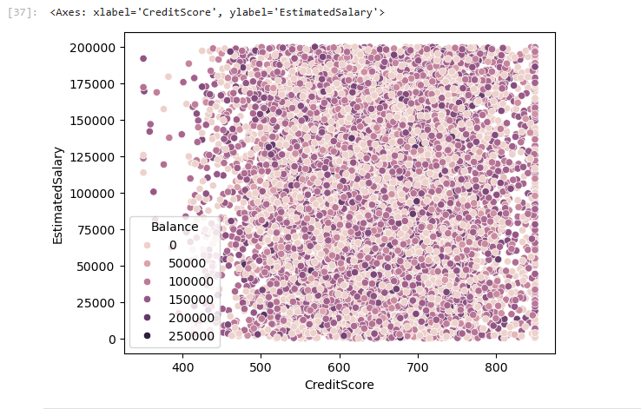
VISUALIZATIONS
Scatter Plot for Credit score and Estimated Salary
ll

Slide 5
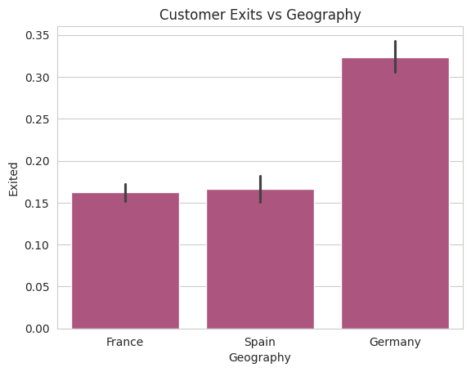
Bar plot for Customer Exits and Geography

Slide 6
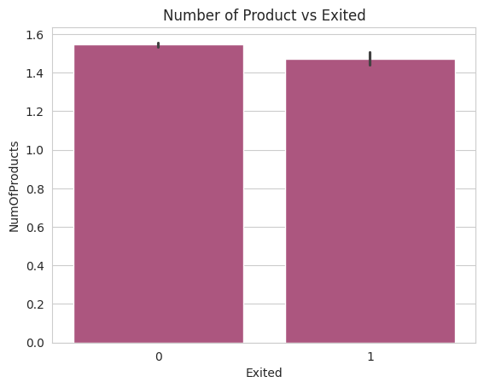
Bar plot for Number of Products and Customer Exits

Slide 7
INSIGHTS
1.Customers with a low credit score have low salaries and are likely to churn
2.There’s a high rate of customers exiting the bank in Germany
3.Customers who purchase more products are likely to stay

Slide 8
MODEL PERFORMANCE TABLE
MODEL | USE | ACCURACY
LogisticRegression | Binary Classification | 0.8149
RandomForestClassifier | Classification and Performance | 0.8528
Xgboost | Performance | 0.8466
Best Model: Random Forest Classifier

Slide 9
RECOMMENDATION
The bank should allow customers to borrow money despite their salaries at a cost to reduce the risk of churning
The bank should introduce more branches in various regions especially Germany so as to minimise the rate of churning
Bank should introduce more products to their customers to lower the risk of churning.

Slide 10
GROUP 2
Joy
Iana
Denis
Ahmed

